Slide 1
IoT for Health: An Integrated System for Monitoring Physiological Parameters and Activity Recognition
Smartphone Interface for Peripheral Sensors
VIVA presentation
Xingchen Chen
S2269664
Notes:
Good afternoon, everyone, I am Chen Xingchen and thank you for joining me today. I am here to present my final project for the Meng degree. My project title is IoT for Health: An Integrated System for Monitoring Physiological Parameters and Activity Recognition. This project stems from the topic: Smartphone Interface for Peripheral Sensors.

Slide 2
catalogue
Project Topic
Project Background
System Design
Implementation
Conclusion
Demo
Notes:
My presentation will unfold as follows: I'll begin with an introduction to the topic as well as the background. Next, I’ll talk about the design and implementation of the system. Then I will conclude with reflections on the project's impact and opportunities for future exploration.
I will also showcase the system's function through a video demonstration and a live walkthrough.

Slide 3
1. Introduction
Topic Overview
Smartphone for Personal Assistant: Leveraging external sensors to enhance smartphone capabilities for health monitoring."
Project Focus
IoT for Personal Healthcare: Facilitating communication between smartphones and external sensors for health data tracking.
Key Features
Measures vital parameters: Heart Rate & SpO2
Human Activity Recognition
Dual Android Applications for both patients and doctors
Cloud data storage
Notes:
Starting from the topic: Smartphone Interface for Peripheral Sensors, with the help of multiple sensors, the smartphone is turning into a sophisticated machine for personal assistance. However, some sensors may not be suitable to be directly incorporated into the smartphone. So, using external sensors and developing a smartphone interface becomes a good option to realize complex features.
This project is mainly about developing an IoT system for personal health care that enables communication between the smartphone and external sensors via Bluetooth.
This system can measure key physiological parameters, including heart rate and blood oxygen saturation level (SpO2), and it is able to recognise Human Activity.
The sensor information is made accessible through two Android applications, the app for patients and the app for doctors, they can not only bridge the gap between patients and their health data but also engage health service providers.

Slide 4
2. Background
Aging Global Population: Elderly population projected to rise from 12% to 22% between 2015 and 2050, increasing healthcare challenges.
Healthcare Challenges
Rise in cardiovascular and respiratory diseases.
Urgent need for innovative health assistance solutions.
Heart rate and SpO2 are important indicators of cardiovascular and respiratory function but are affected by physical activity.
By combining HAR with biometric sensors, an IoT system can provide a comprehensive view of health status.
Need for solutions that connect the patient and doctors.
Notes:
Why do we want to develop such a product?
The global population is undergoing a significant shift, with the population of the elderly rising from 12% to 22% between 2015 and 2050. This increase causes more healthcare challenges like cardiovascular and respiratory diseases. This rising trend underscores the urgency for innovative health care solutions.
One key strategy is the early detection of health problems, which requires monitoring health parameters, like heart rate and SpO2. However, the standard of these parameters can vary depending on the physical activity of the person. Therefore, it is necessary to take into account human activity when measuring them. What’s more, the health monitoring products today are usually for patients only, making it difficult for doctors to give help in a timely manner. This idea forms the premise of this project.

Slide 5
3. System Design
Development tools
System architecture
Patient APP
Doctor APP
Notes:
In the system design part, I will talk about the following points
First is the development tools, then the Architecture for the entire system,
Finally introduce the Interface of the 2 applications

Slide 6
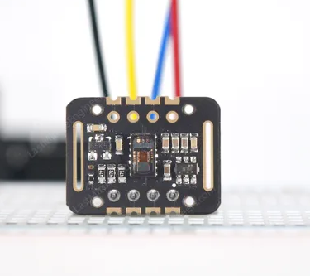

3.1 development tools
MAX30102
Nordic Thingy:52
Nordic Thingy-52
MAX30102 sensor for heart rate and SpO2 measurement
Nordic Thingy-52 sensor with inertial measurement unit (IMU) for human activity recognition
Combination of these sensors enables comprehensive health monitoring
Notes:
For the sensor part, this project employs the MAX30102 sensor for measuring heart rate and SpO2 and the Nordic Thingy-52 for measuring the IMU movement data for Human Activity Recognition.

Slide 7

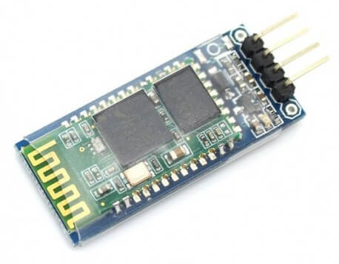
3.1 development tools
Bluetooth module HC-06
Arduino Uno
Arduino served as controller for MAX30102.
Bluetooth module HC-06 connect the Arduino and the smart phone.
Notes:
An Arduino Uno microcontroller is used to manage the sensors, and the HC-06 Bluetooth module for data transmission to the smartphone.

Slide 8


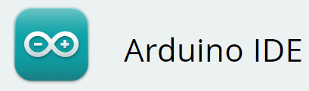
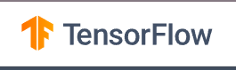
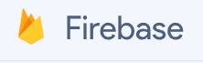
3.1 development tools
Notes:
For the software part, the Arduino IDE is used to program the Arduino, the android studio is used for app development, Jupyter Notebook and the TensorFlow library are used for machine learning model development, and firebase is used for cloud service of authentication and data storage.

Slide 9
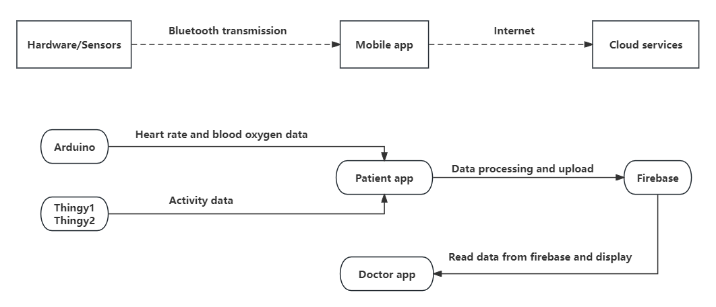
3.2 System architecture
Notes:
The whole system comprises three main parts: hardware (sensors), mobile applications (Doctor and Patient apps), and cloud services (Firebase).
The working flow of the system goes like this:
First, sensors are connected to mobile phones with the Patient app, the MAX30102 sensor two Thingy:52 motion sensors.
The Patient app receives data from the sensors and displays the user’s physiological data. It also takes the IMU data readings and run the ML model and show the activity recognition result. It then uploads the data to Firebase.
Firebase serves as the central data storage, storing all patients’ data categorized by username, date, and data type.
The Doctor app retrieves patient data from Firebase, displaying it in graphical formats such as bar charts and scatter plots, providing physicians with insights of patients’ physiological conditions.

Slide 10
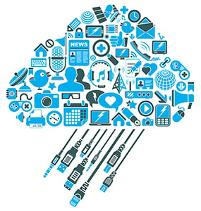
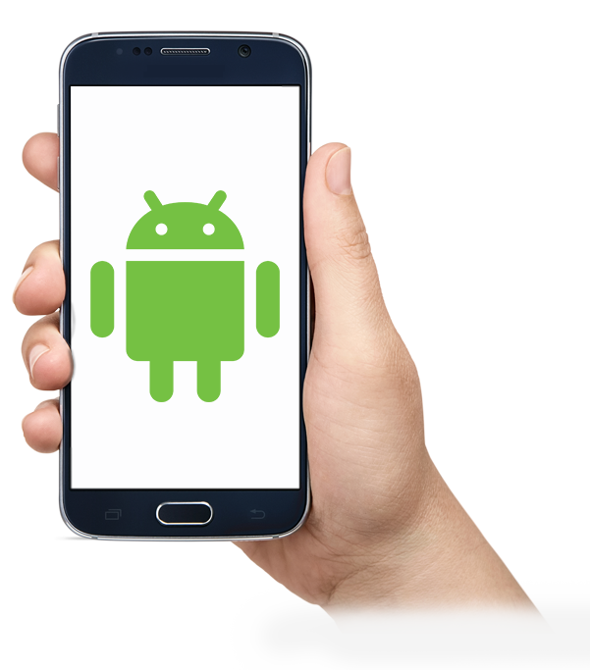
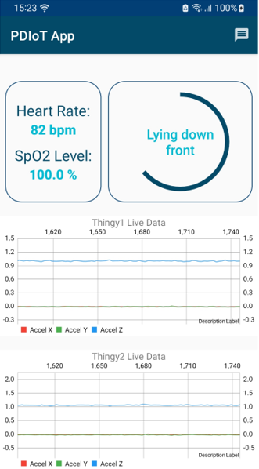
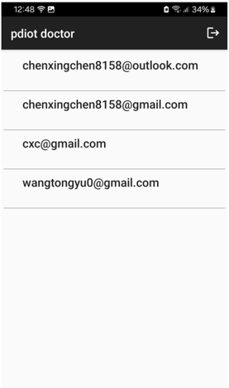
3.2 System architecture
Firebase
MAX30102
HC-06
Arduino Uno
*2
Patient APP
Doctor APP
Nordic Thingy:52
Nordic Thingy-52
Notes:
This is a more visualized presentation of the System architecture

Slide 11
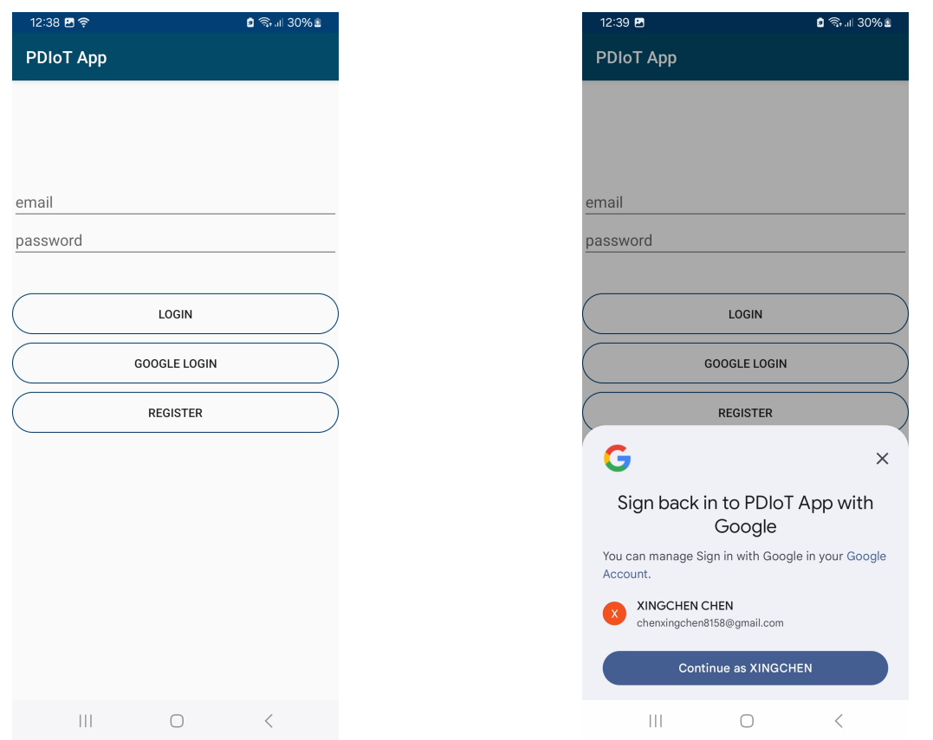
3.3 patient app
Notes:
About app interface we start with the patient app. On opening the app, users will encounter the user authorization page. Patients can use Email and Password or Google Account Authentication for signup and login.

Slide 12
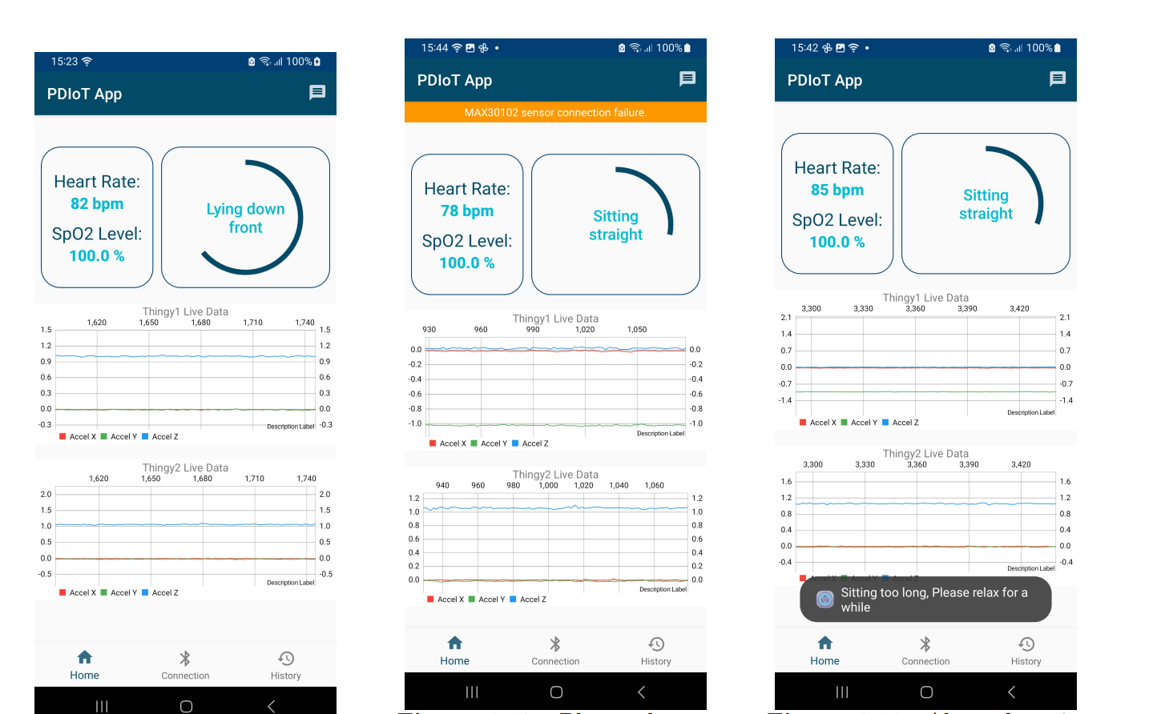
3.3 patient app
Notes:
After logging in, the ’Home’ page becomes the primary interface for the user.
The top left corner displays real-time heart rate and SpO2 levels.
Activity recognition result is in the top right corner. The circular component illustrates the prediction’s probability—for instance, three-quarters of the circle turns blue when the probability is 75%.
These predictions typically have a two-second delay due to the data processing time.
Two live graphs at the bottom of the page showcase real-time accelerometer data from both Thingy sensors.
In the second picture, if the Arduino sensor data isn’t received for a while, a prompt will show up to remind the user.
The system also monitors sedentary behaviour—if the user remains seated too long, the app reminds them to take a break.

Slide 13
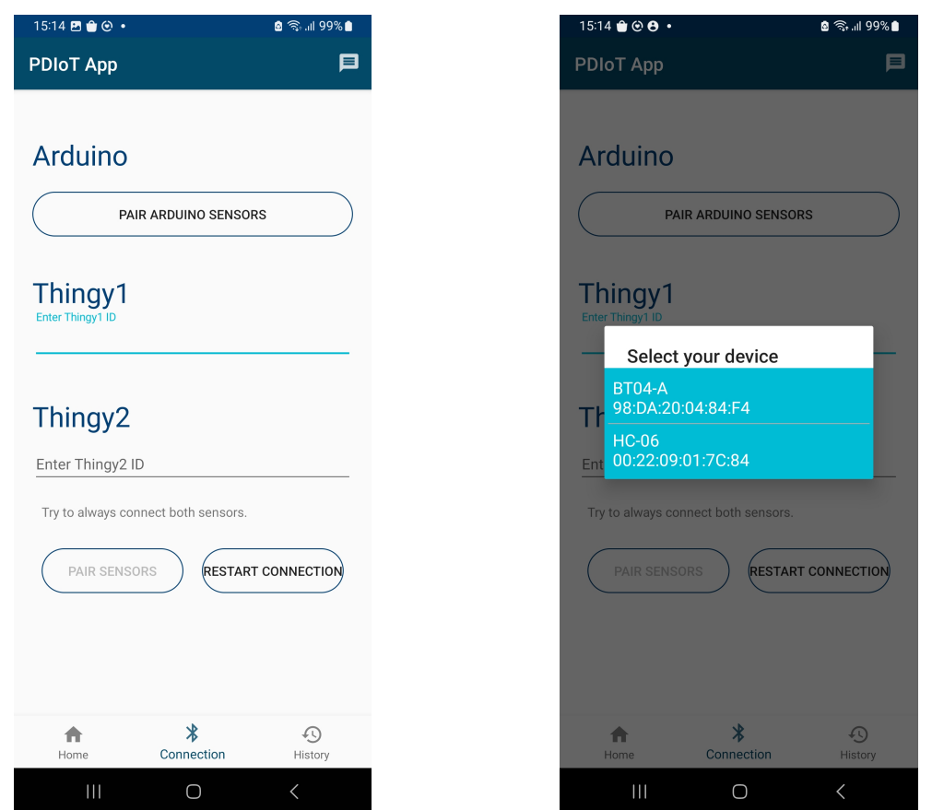
3.3 patient app
Notes:
Of course, before using any of these functionalities, the user needs to connect the sensors via the connection page.
Press ’Pair Arduino Sensor’ to connect with the MAX30102 sensor.
For the thingy sensor, we can enter the MAC address to pair them.

Slide 14
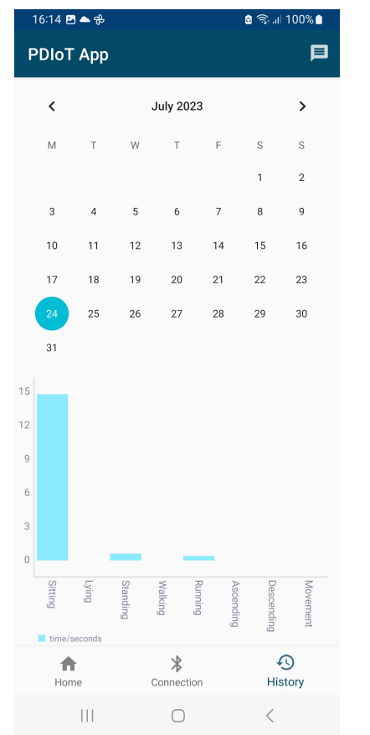
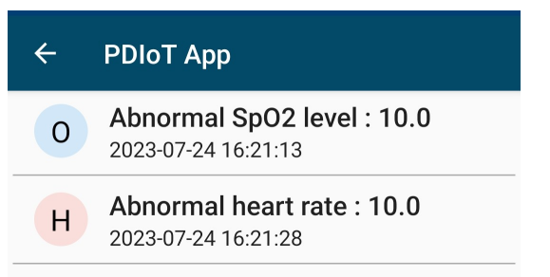
3.3 patient app
Message button
Notes:
Patients can use the ‘History’ function to review past activity data. By selecting a date, the app displays a bar chart showing each activity in that day, with the activity name on the x axis and the duration on the y axis.
The application features a ’Message’ button at the top right corner. It notifies users of any detected abnormalities in heart rate and SpO2 levels with the time and readings.

Slide 15
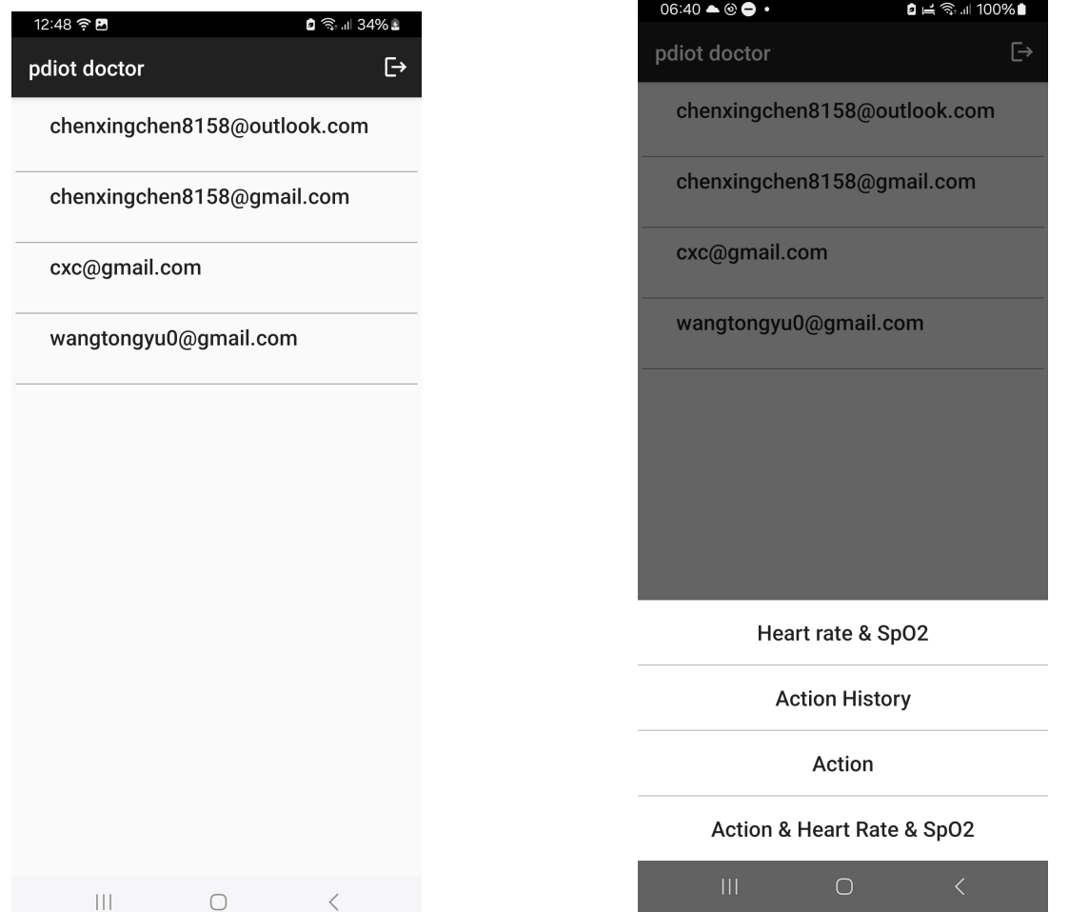
3.4 Doctor app
Notes:
That’s all for the patient app, the doctor app is simpler. For the doctor app, the main function is to view the patient’s data,
After login, The home page of the doctor app shows the Patient List by their emails, and the doctors can select and view specific health data of a patient.
After clicking a patient’s email, the app provides four types of health data visualizations:

Slide 16
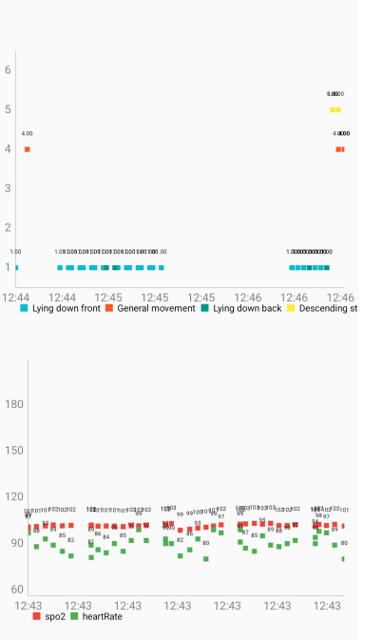
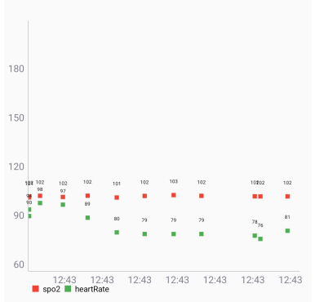
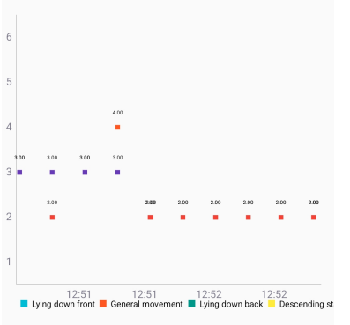
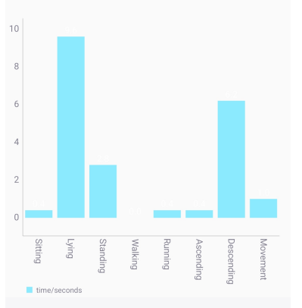
3.4 Doctor app
Heart Rate and SpO2 Over Time
Activity Over Time
Duration of Each Activity
Combined data
Notes:
After clicking a patient’s email, the app provides four types of health data visualizations:
I mainly used a scatter plot to represent the sensor readings and recognition results at each time
Doctors can view heart rate and spo2 level and activity separately in the first 2 paragraphs, they also view them together so they can know the heart rate and spo2 level when the patient perform a certain activity.
1. Heart Rate and SpO2 Over Time (scatter plot) doctors can check the values at each time.
2. Activity Over Time (scatter plot)
3. Duration of Each Activity: same as the history function of the patient app.
4. Combined Heart Rate, SpO2, and Activity: This view correlates all data for comprehensive analysis, so that it is easier for doctors to know the heart rate and spo2 level when the patient perform a certain activity.

Slide 17
4. Implementation
Sensor implementation
Machine learning model
Online database setup
Notes:
Next, I will talk about some key implementation methods for this project.

Slide 18
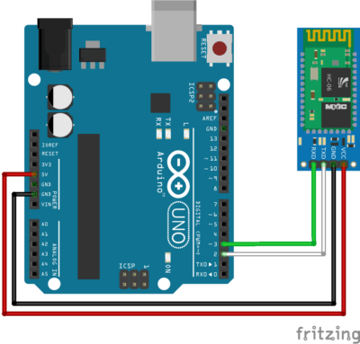
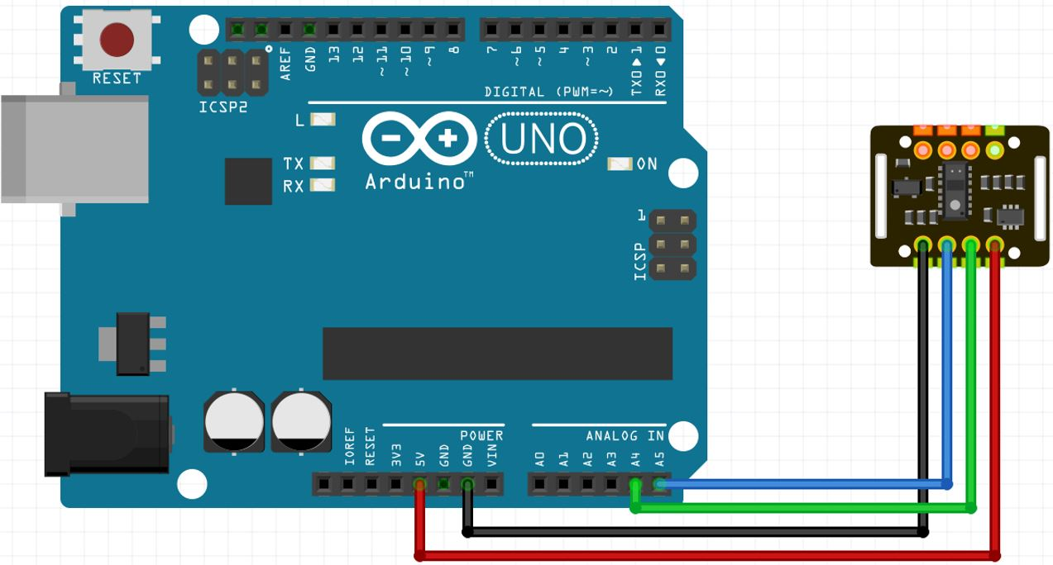
4.1 Sensor implementation
SpO2 Sensor Implementation:
Use Arduino control board to control the sensor
Wire the sensor and take readings from the serial port
Communicate with the phone using HC-06 Bluetooth module
Send and receive data with general Bluetooth apps
Notes:
For the MAX30102 sensor, I designed the circuit like this. After receiving the data through the serial port, we can it to the phone through a Bluetooth interface.

Slide 19
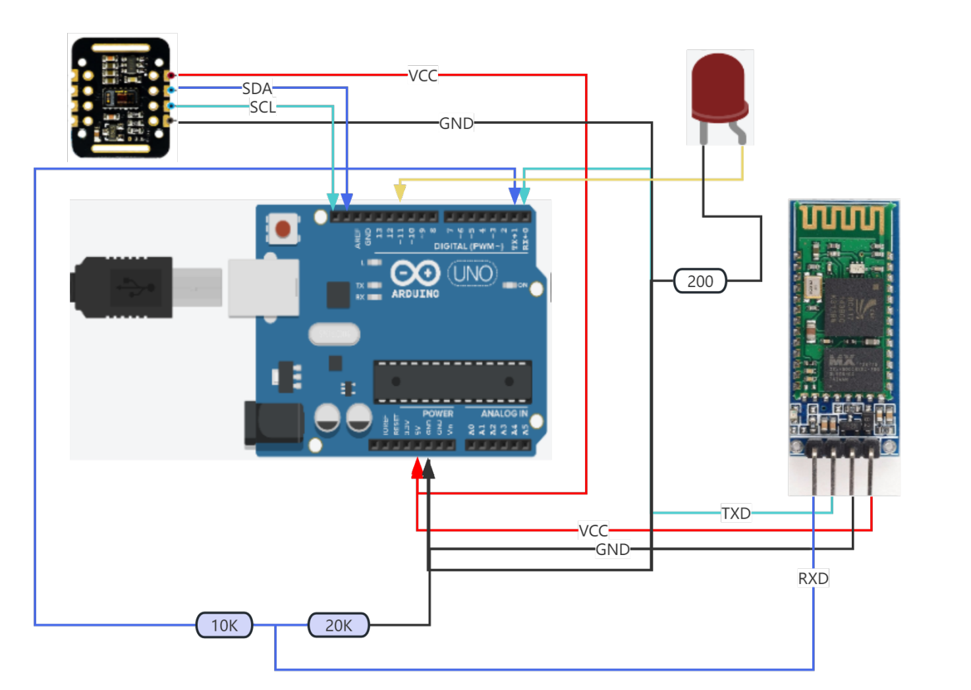
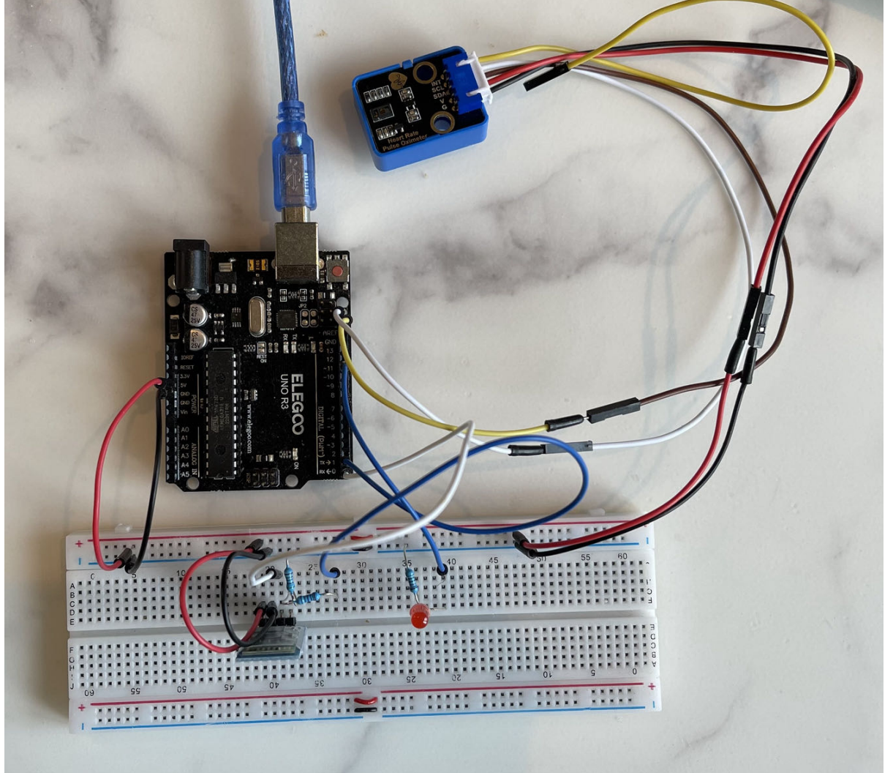
4.1 Sensor implementation
schematic diagram
picture of real products
Notes:
Left side: schematic diagram
Right side: picture of real products

Slide 20
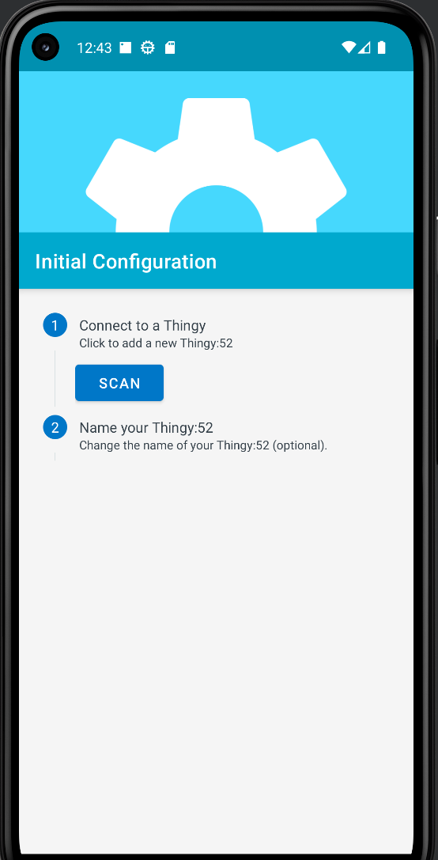
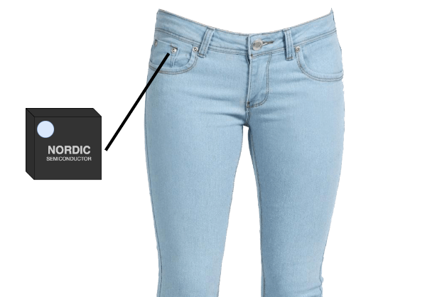
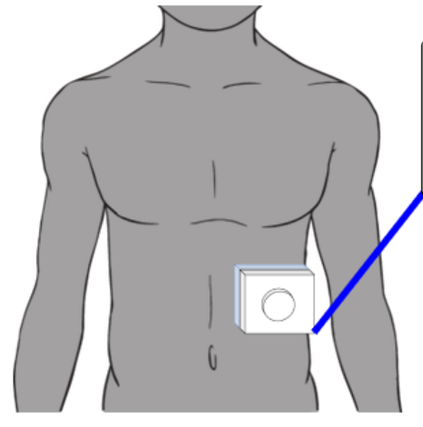
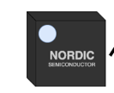
4.1 Sensor implementation
Thingy-52 Sensor Implementation:
The sensor already has Bluetooth built-in
Nordic company open sourced an Android app to communicate with the sensor.
Use two sensors to detect activities more accurately.
Notes:
For the Thingy-52, it already has a Bluetooth-Low-Energy module built in it.
I use 2 of them and attach them to different parts of the human body, one on the upper body and one on the lower body for more accurate activity prediction.

Slide 21
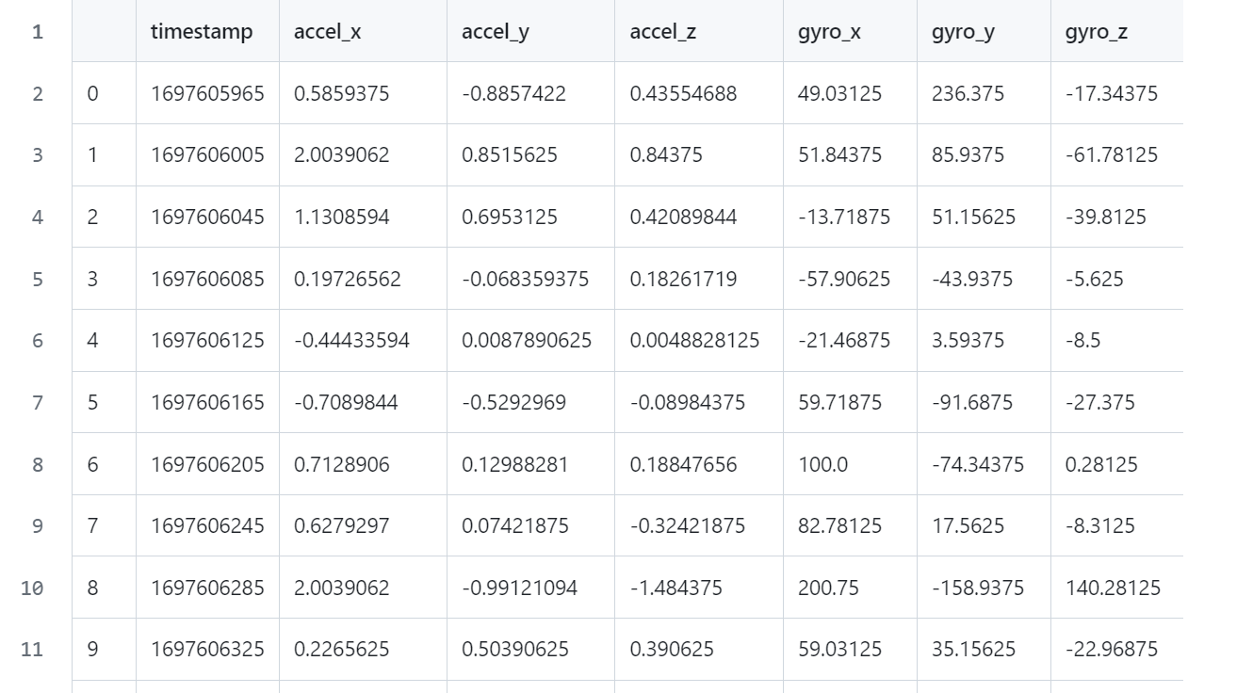
4.2 Machine learning model
The ML model is a key part in the HAR subsystem.
This model is trained to classify 14 human activities based on sensor data.
Sitting straight Sitting bent forward Sitting bent backward Standing Lying down left Lying down right Lying down front Lying down back Walking Running Ascending stairs Descending stairs Desk work General movement
Notes:
The machine learning model is a key part in the HAR subsystem. This model is trained to classify 14 human activities based on sensor data.
The data utilized in this research is gathered from an open-source repo, and the main format of the data looks like this: acceleration in x, y, z axis and gyroscope reading in x, y, z axis. Each file is labelled with the corresponding activity type.

Slide 22
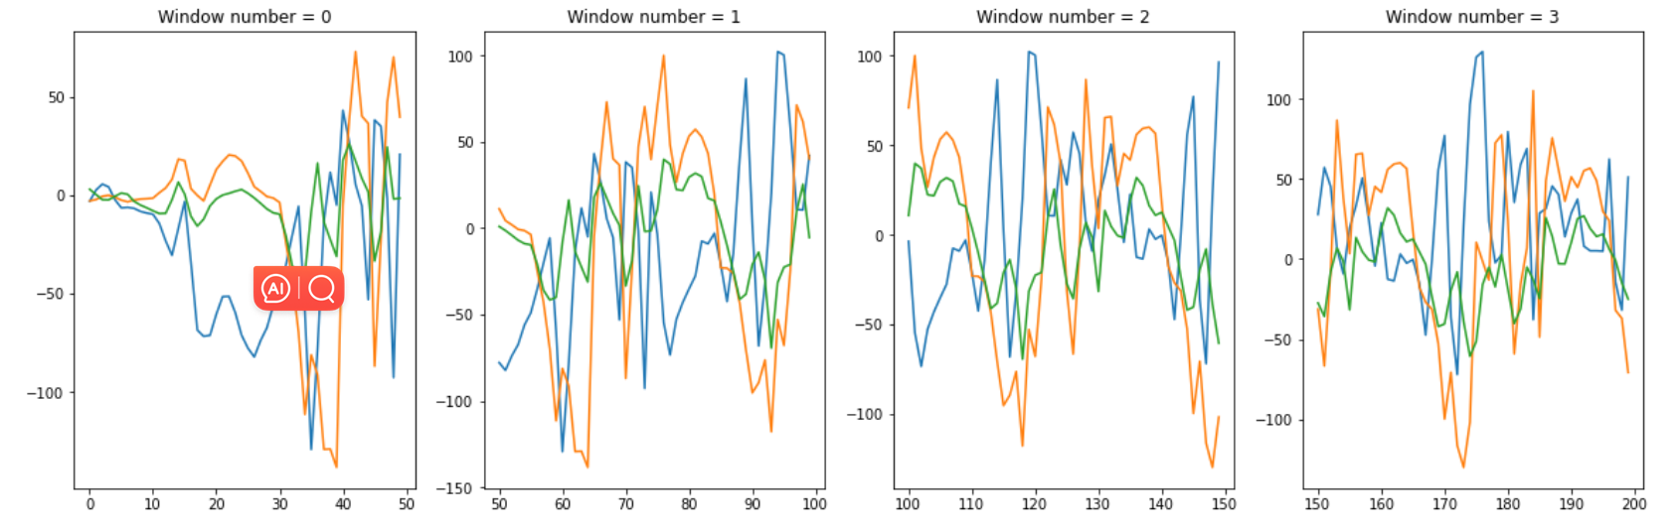
4.2 Machine learning model
Data collected at a frequency of 25Hz
25 data samples per second
Consider a subset of consecutive data as one instance
Window size: 50
sliding windows
Notes:
This is time series data and collected at a frequency of 25Hz, which means 25 data samples per second.
To process them for training, I applied the sliding window technique, all data is to be split into data blocks like windows. The sliding window approach allows the model to consider a subset of consecutive data as one instance and better recognize the pattern of the activities. A window size is 50, which equates to 2 seconds of data collected.
After splitting the data into data blocks, it can be feed into a ML model.

Slide 23
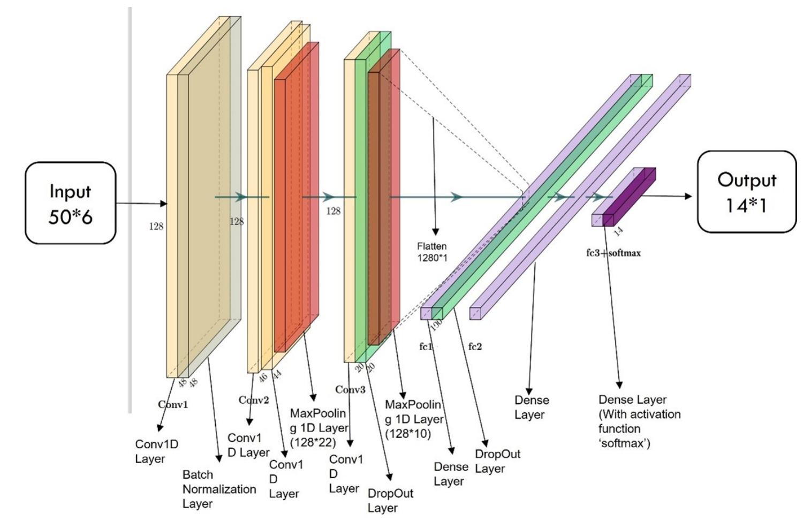
4.2 Machine learning model
Notes:
The model mainly uses the convolutional neural network(CNN) model, it starts with the fifty times six input, the number 6 corresponds to the 6 data types here, 50 is the number of the samples in one sliding window.
There are 4 yellow 1Dimentionel CNN layers. They are used to extract the features of the data in depth.
Between these convolutional layers, some layers are added to decrease the overfitting.
The batch normalization layer to make all samples in a minibatch standardized, so the network will not be affected by an extra-large training sample.
Max-pooling layers for removing the relatively small values
Two dropout layers to randomly remove some values to enhance the model’s generalisation ability.
In the middle, there is a flatten layer used to transform the multi-dimensional tensor into single dimension so that the structure fit with the format of the output.
After refining the model with some more dense layers, for the last dense layer, use the softmax activation function to transfer the output to probability values.

Slide 24
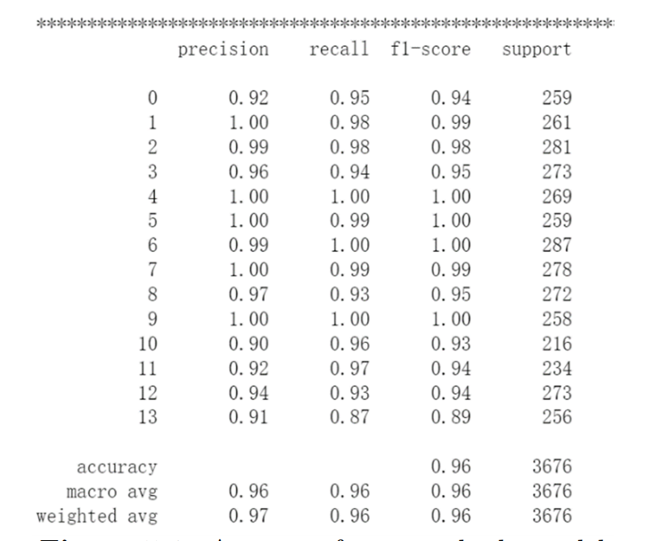
4.2 Machine learning model
Notes:
The model has an accuracy of 97% using 80% data as training set and 20% data as testing set.
After the model, the model is exported as a TFLite file for mobile integration.

Slide 25
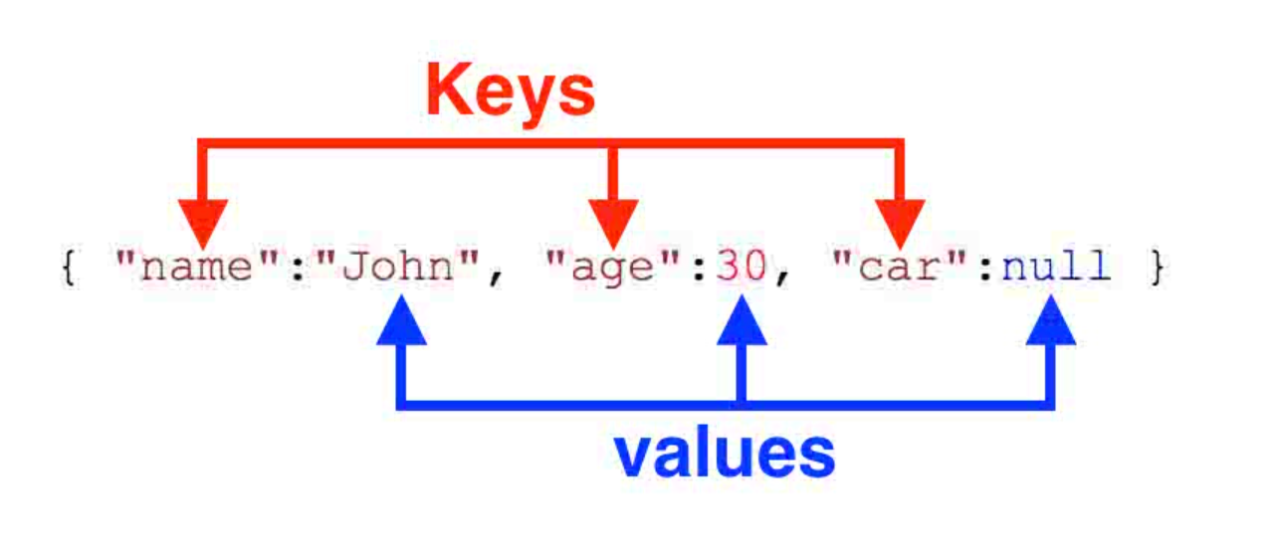
4.3 Online database design
The Firebase Realtime Database is a cloud-hosted database.
Data structure: JSON tree
All data using Firebase Realtime Database is stored as JSON objects. You can think of the database as a cloud-hosted JSON tree.
When adding data to the JSON tree, it becomes a node in the existing JSON structure with an associated key.
Notes:
Next I will talk about the on line database design. To enable the doctor app to access the patients data from another device, the data must be stored in the cloud. I chose the firebase to realize this functionality.
The Firebase Realtime Database is a cloud-hosted database provided by google with a complete set of APIs that allows us to read and write data conveniently in real-time.
How is data structured: it's structured in a JSON tree format.
A Json tree is a connected set of Json objects. Each Json objects has a key and a value, like this one. One Json object can be a Jason value for another Json object, that is how we form a Jason tree.
This is a NoSQL database. Unlike a SQL database, there are no tables or records. When you add data to the JSON tree, it becomes a node in the existing JSON structure with an associated key.

Slide 26
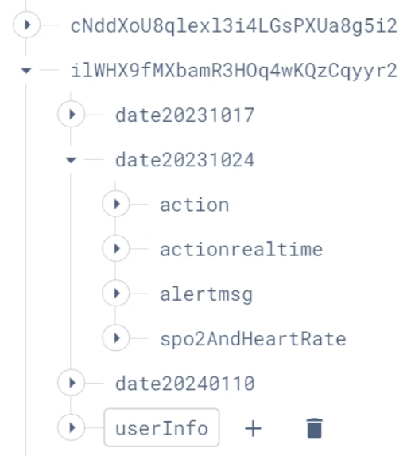
4.3 Online database design
User ID
Date
Duration of each action
Time and action of that time
Alert message
Time and heart rate and spo2 of that time
User Email
Notes:
At the top level, the data is categorized by individual users, each user has a unique UID like this. I also added a user Info part under each UID containing details like the user’s email.
Data under each user is further organized by date.
Within each date entry, there are 4 categories of data:
1. Action: Duration of each type of activity throughout the day.
2. ActionRealtime: The activity at each recorded moment.
3. AlertMsg: contain the alert messages generated.
4. Spo2AndHeartRate: Heart rate and SpO2 levels recorded at each recorded moment.
Then we can use the getvalue function and setvalue function to access the data in the doctor and patient app.

Slide 27
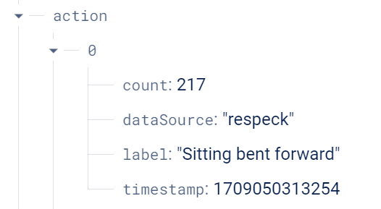
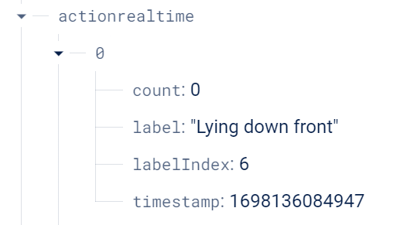
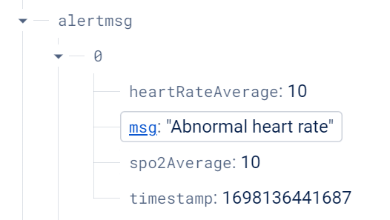
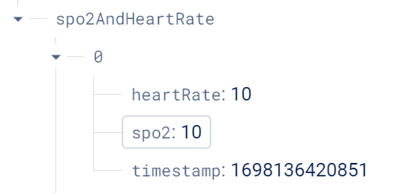
4.3 Online database design
Notes:
This is the lower level or the leaves of the JSON tree.

Slide 28
5 conclusion
Innovation point
Combining activity type with heart rate and spo2 data
The patient and doctor applications.
Further development
Add more sensor types
Implement machine learning for other sensors data
Develop cross-platform applications for it.
Notes:
As we conclude, I'd like to reflect on the journey of this project.
A pivotal advancement has been combining activity type with heart rate and spo2 data for more comprehensive analysis and developing the patient and doctor applications.
This approach has not only enhanced patient engagement with their health data but also streamlined healthcare processes. Patients no longer have to physically go to the hospital to have their heart rate checked to receive advice.
Looking forward, the project sets the stage for further innovations. We can add more sensor types and implement machine learning other sensors for detailed physiological data analysis. Currently it only runs on android, so we can also develop cross-platform applications for it.

Slide 29
THANK YOU
Xingchen Chen

Slide 30
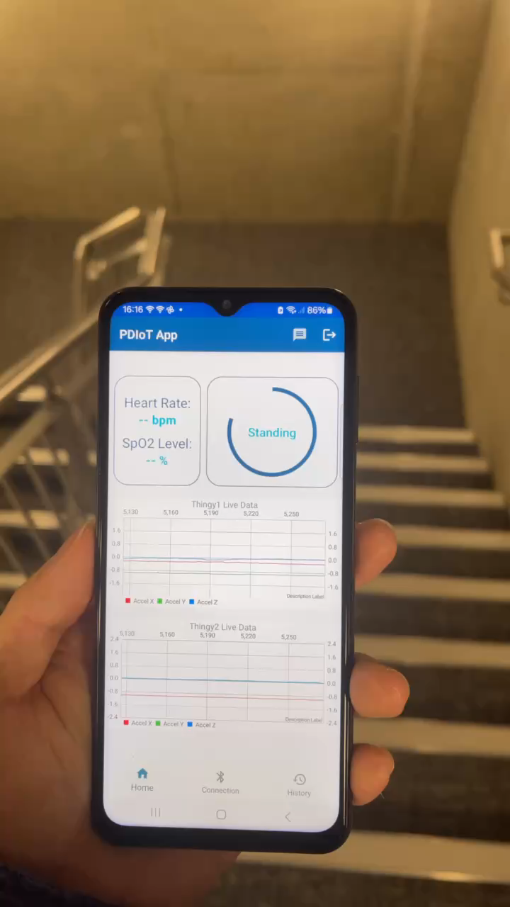
6 demo – descende stairs

Slide 31
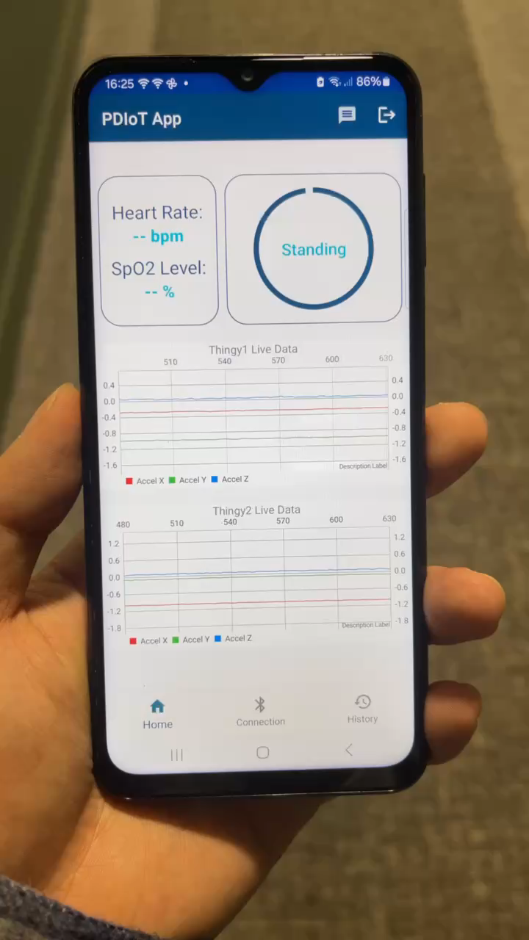
6 demo - walk

Slide 32
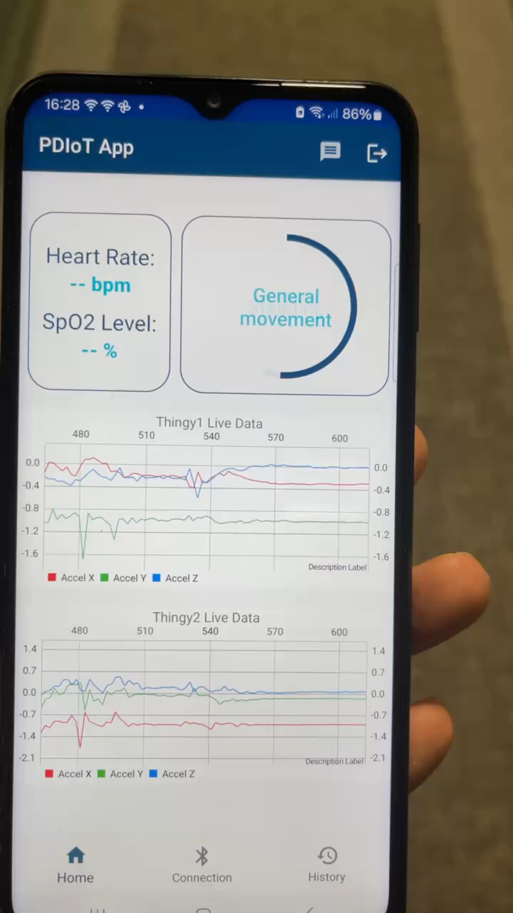
6 demo - run

Slide 33
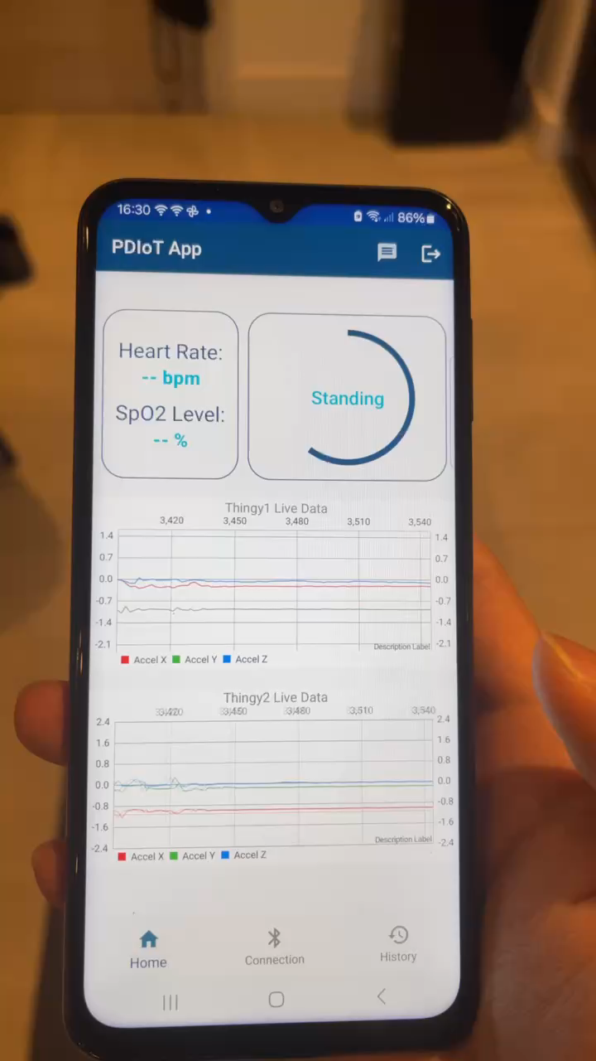
6 demo - lie down

Slide 34
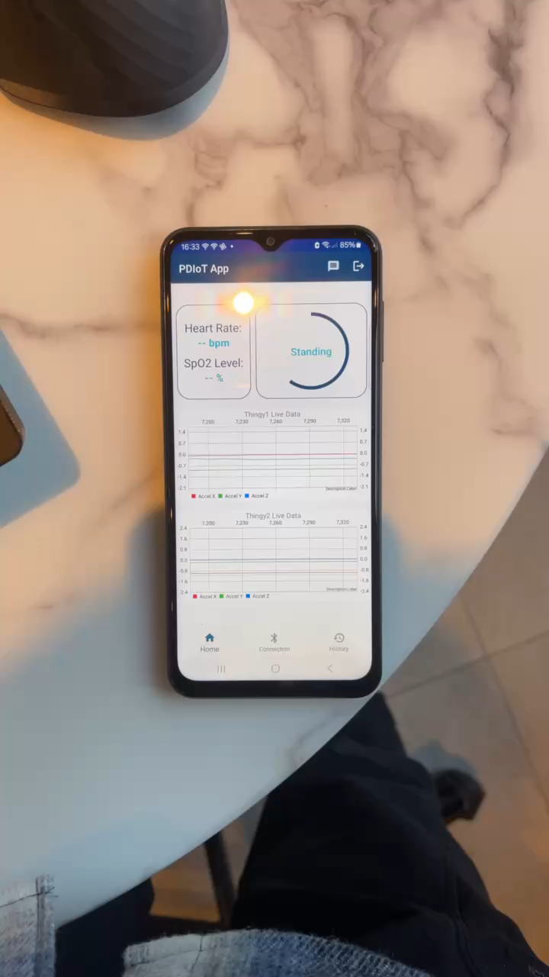
6 demo – sit & movement

Slide 35
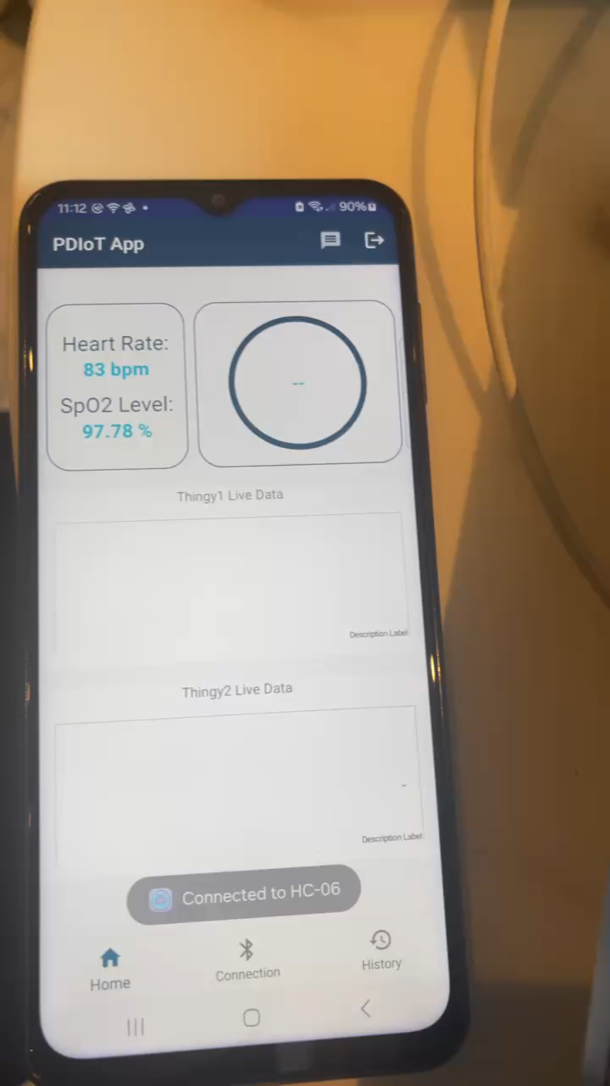
6 demo – SPO2 and heart rate

Slide 36
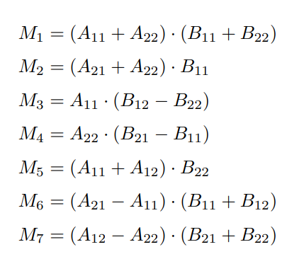
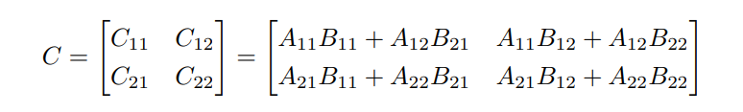
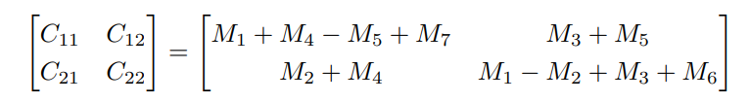
4.4 ML training acceleration
Eigen Library: a high-level C++ library for matrix operations
Strassen Algorithm: reducing time complexity of matrix multiplication from n^3 to n^2.7.

Slide 37
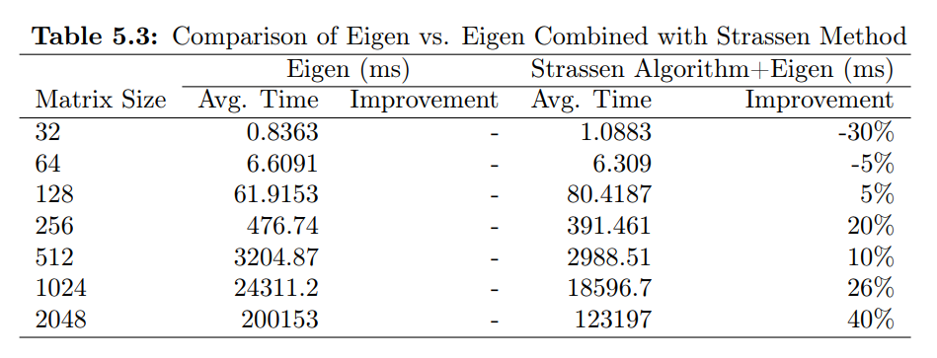
4.4 ML training acceleration
Eigen Library: a high-level C++ library for matrix operations
Strassen Algorithm: reducing time complexity of matrix multiplication from n^3 to n^2.7.

Slide 38
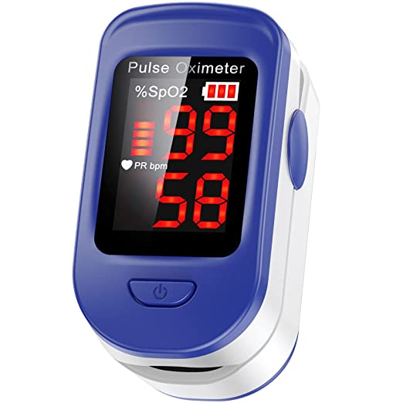
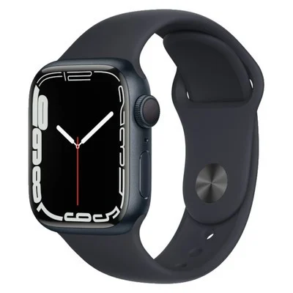
Competing products
Other IoT SPO2 projects
Use IoT chip ESP8266
Not connected to mobile device.
Not flexible
Limited functions
Cannot adjust based on activities
Expensive
cannot detect postures

Slide 39
Functionalities
SpO2 levels may naturally drop slightly during sleep but should remain above 90%. Low SpO2 levels during sleep could indicate health issues such as sleep apnea.
SpO2 levels can also fluctuate during exercise, with normal levels ranging from 95% to 100%. If levels fall below 90%, it may suggest hypoxia.
Monitoring SpO2 levels alone is important, but incorporating an IMU sensor can provide additional benefits.
The IMU sensor can track daily activity levels, detect falls.
Combining SpO2 measurement with IMU data provides a more comprehensive understanding of overall health and physical activity levels.

Slide 42
Competitors

Slide 43
PRESENTATION TITLE
Mirjam Nilsson

Slide 45
AGENDA
Introduction
Primary goals
Areas of growth
Timeline
Summary

Slide 46
INTRODUCTION
At Contoso, we empower organizations to foster collaborative thinking to further drive workplace innovation. By closing the loop and leveraging agile frameworks, we help business grow organically and foster a consumer-first mindset.​

Slide 48
PRIMARY GOALS
Annual revenue growth

Slide 49
QUARTERLY PERFORMANCE

Slide 50
AREAS OF GROWTH
​ | CATEGORY 1 | CATEGORY 2 | CATEGORY 3​ | CATEGORY 4​
Q1 | 4.5​ | 2.3​ | 1.7​ | 5​.0
Q2 | 3.2​ | 5.1​ | 4.4​ | 3​.0
Q3 | 2.1​ | 1.7​ | 2.5​ | 2.8​
Q4 | 4.5​ | 2.2​ | 1.7​ | 7.0

Slide 51
BUSINESS OPPORTUNITIES ARE LIKE BUSES. THERE'S ALWAYS ANOTHER ONE COMING.​
Richard Branson

Slide 52




MEET OUR TEAM
TAKUMA HAYASHI
MIRJAM NILSSON
FLORA BERGGREN
RAJESH SANTOSHI
President
Chief Executive Officer
Chief Operations Officer
VP Marketing

Slide 54








MEET OUR TEAM
TAKUMA HAYASHI
MIRJAM NILSSON
RAJESH SANTOSHI
RAJESH SANTOSHI
President
Chief Executive Officer
Chief Operations Officer
VP Marketing
GRAHAM BARNES
ROWAN MURPHY
ELIZABETH MOORE
ROBIN KLINE
VP Product
SEO Strategist
Product Designer
Content Developer

Slide 55
PLAN FOR PRODUCT LAUNCH
Deploy strategic networks with compelling e-business needs
PLANNING
Synergize scalable e-commerce
MARKETING
Disseminate standardized metrics
DESIGN
Coordinate e-business applications
Foster holistically superior methodologies
LAUNCH
STRATEGY

Slide 56
TIMELINE
Q1
Synergize scalable e-commerce
Q2
Coordinate e-business applications
Q3
Deploy strategic networks with compelling e-business needs
Q4
Disseminate standardized metrics

Slide 57
AREAS OF FOCUS
B2B MARKET SCENARIOS
CLOUD-BASED OPPORTUNITIES
Develop winning strategies to keep ahead of the competition
​Capitalize on low hanging fruit to identify a ballpark value
​Visualize customer directed convergence​
Iterative approaches to corporate strategy
​Establish a management framework from the inside​

Slide 58
HOW WE GET THERE
ROI
NICHE MARKETS
SUPPLY CHAINS
Envision multimedia-based expertise and cross-media growth strategies​
​Engage worldwide methodologies with web-enabled technologies​
Pursue scalable customer service through sustainable strategies​
Engage top-line web services with cutting-edge deliverables​​​
Cultivate one-to-one customer service with robust ideas​
Maximize timely deliverables for real-time schemas​

Slide 59
SUMMARY
At Contoso, we believe in giving 110%. By using our next-generation data architecture, we help organizations virtually manage agile workflows. We thrive because of our market knowledge and great team behind our product. As our CEO says, "Efficiencies will come from proactively transforming how we do business."​

